Slide 1

Data Streaming
Dr. Nilay Karade
Academic Head

Slide 2
Agenda
Example of streaming
What is Kafka?
Kafka components
Producer
Broker
Consumer
Zookeeper
Topics
Partition
Implementation

Slide 3
Example of streaming data
Ecommerce
Financial transaction (stock prices or bank transactions)
Map services
Taxi booking
Social media

Slide 4
Apache Kafka
Apache Kafka is an open-source distributed event streaming platform that is designed for building real-time data pipelines and streaming applications.
Developed by the Apache Software Foundation, Kafka provides a highly scalable, fault-tolerant, and distributed publish-subscribe messaging system.

Slide 5
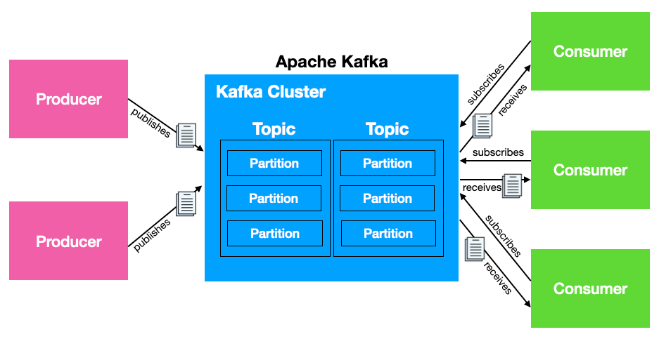
Apache Kafka Architecture
Producer
Sensors, Stock market,
Software applications
Consumer
Software applications
Reports, Dashboards
Broker
Server
Zookeeper
Resource manager
Broker
Zookeeper
Source: Wei-Meng Lee

Slide 6
Apache Kafka Architecture
Broker
Zookeeper
Source: Wei-Meng Lee

Slide 7
Apache Kafka Architecture
Topics
Create order
Cancel order
Shift order
Consumer
Software applications
Reports, Dashboards
Broker
Server
Zookeeper
Resource manager
Broker
Zookeeper
Source: Wei-Meng Lee

Slide 8
Kafka Components
Producer: A producer is a component or application that sends data or messages to Kafka topics. Producers publish data to Kafka, which is then made available for consumption by consumers.
Broker: A broker is a Kafka server that stores and manages the data published by producers. Multiple brokers form a Kafka cluster, and each broker handles data storage, replication, and distribution.
Consumer: A consumer is a component or application that subscribes to and reads data from Kafka topics. Consumers process and use the data published by producers.
Zookeeper: Apache ZooKeeper is a distributed coordination service often used with Kafka. It helps manage and coordinate Kafka brokers and provides essential functions like leader election and distributed synchronization.
Topics: Topics are logical channels or categories to which data is published by producers and from which data is consumed by consumers. Topics organize data streams within Kafka.
Partition: Topics can be divided into partitions, which are the basic unit of parallelism and scalability in Kafka. Partitions allow data to be distributed across multiple brokers, enabling high throughput and fault tolerance.

Slide 9
Java installation
https://www.oracle.com/in/java/technologies/javase/javase8-archive-downloads.html
https://www.geeksforgeeks.org/download-and-install-java-development-kit-jdk-on-windows-mac-and-linux/

Slide 10
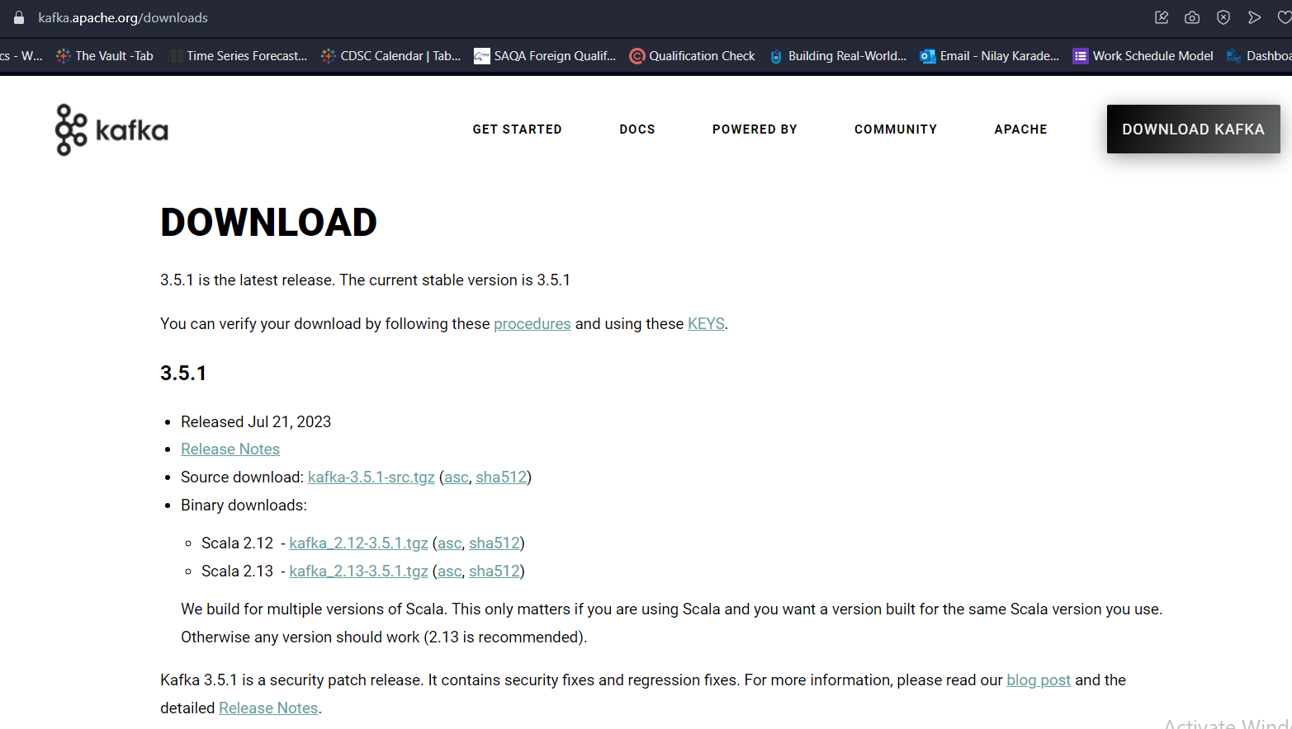
https://kafka.apache.org/downloads

Slide 11
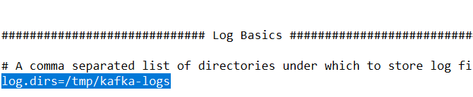

Config/server.properties
log.dirs=C:/kafka_2.12-2.8.2/kafka-logs
Config/zookeeper.properties
dataDir=C:/kafka_2.12-2.8.2/zookeeper-data

Slide 12
Steps to run Kafka (ref command file)
Installation of Kafka
Start zookeeper
Start Kafka broker
Create topic
Start the producer
Producer will send the message of the topic
Consumer consumes the message

Slide 13
